Slide 1
FINALS WEEK
Notes:
This week all I’ve wanted to do is escape my finals, my responsibilities, my stresses. I am sure you all can relate, at least on a level. It’s hard to put things in perspective during times like these. You feel pressure to do well and succeed but also frequently neglect to manage the stresses that hard work, and daily routines (as I discussed in my previous presentation on spontaneity) can cause on your body, your mind, your relationships, and your life. An antidote to this narrowmindedness is simple in concept but not in nature. It is to remember to look up, and think of what is above and around us. We are specks of dust, like Horton hears a Who.

Slide 2
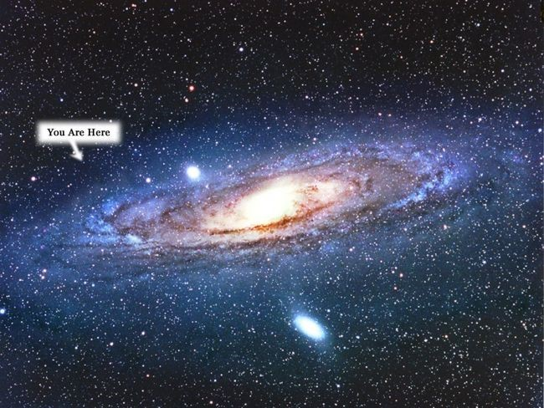
Notes:
Astronomy compels the soul to look upward, and leads us from this world to another.
— Plato, The Republic, 342 BCE.
Astronomy, as defined by space.com is “the study of the sun, moon, stars, planets, comets, gas, galaxies, gas, dust and other non-Earthly bodies and phenomena.” Humans have been looking to the stars to piece together the puzzle of existence since our arrival on this earth.
Today I’m going to try to put things a little more in perspective. I am going to show you just how connected, and interstellar, we all really are.
I will be discussing key details and fun facts about the planets and some other interesting components of our solar system, as well as touch on the sheer magnitude of the universe itself. In our infinitely large universe, you will found as I have, how infinitely small we are.

Slide 3
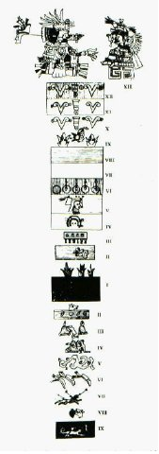
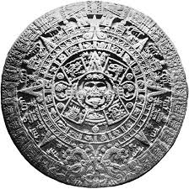
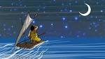
Notes:
According to Scienceing.com ancient people as early as 5,000 years ago used the stars and planets to develop calendars. The rising and setting of the sun signified the beginnings and endings of days. The phases of the moon and stars represented the approximate lengths of the month and the seasons.
Ancient people also used the sky to tell stories. According to the Space Online Today website, astronomical observations used to create such stories were carved into the stone of caves by ancient civilizations as long as 30,000 years ago.
People also used stars to navigate the seas, realizing that some constellations only appear in the one part of the sky. Such as the Big Dipper in the Northern sky. The mathematics could also be more accurate. Onboardintelligence.com explains the process of celestial mechanics, which is involves the use of a precision tool called a sextant to calculate the angle between the star and the observer to find exact latitude and longitude.
Another benefit to astronomy was ancient peoples ability to now to track planting and harvest seasons- therefore making more sustainable agriculture. The Mayans were one of the most notable groups to practice this. They had more assurance that their people would not starve and therefore could invest their time in other means. This heavily promoted and influenced the civilizations incredible progress the website StarTeachAstronomy argues.
Now that we have gone over a little about the history of astronomy benefits, let’s learn why the study is so interesting. The real-world application…

Slide 4
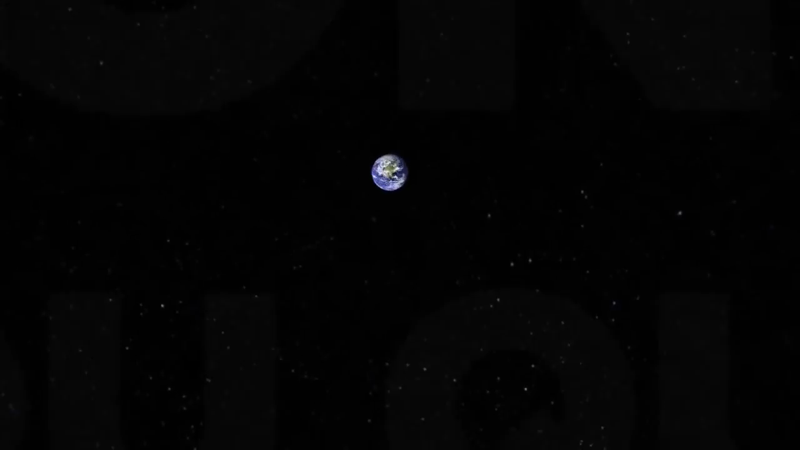
Notes:
Let us begin with a little history about our home planet, earth.
The earth was formed 4.54 billion years and is the only known planet to support life that we have found.
According to the website The Planets, “Earth is the only planet in the solar system not named after a mythological being. Instead, its name is derived from the Old English word "ertha" and the Anglo-Saxon word "erda" which means ground or soil.”

Slide 5
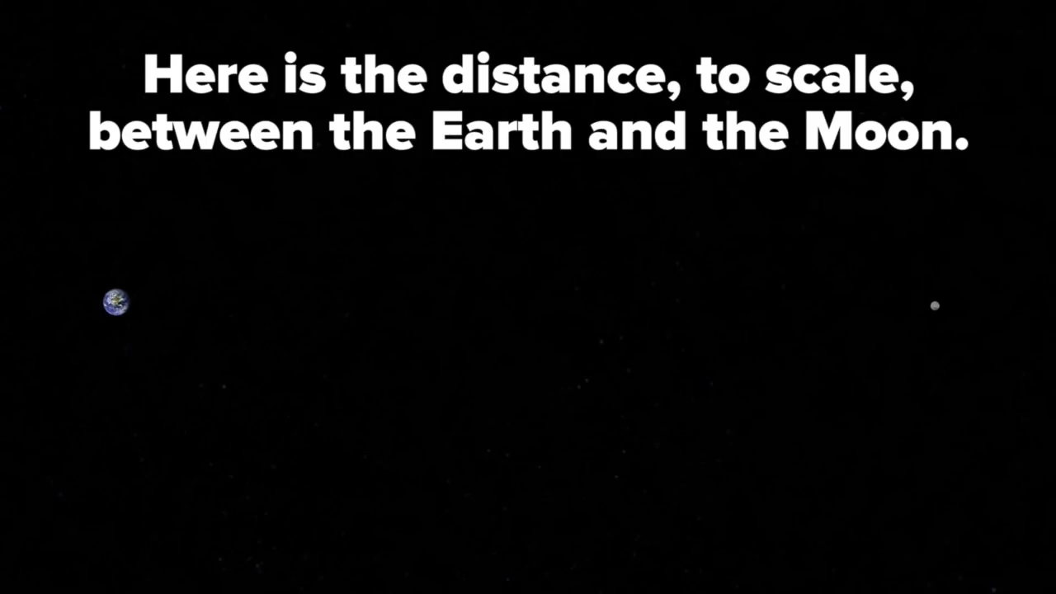
Notes:
Within the distance between the earth to the moon you can fit every planet inside our solar system, still with about 4,392 km or 2,729 miles to spare.
Lets talk about the solar system and those planets more in depth…

Slide 6
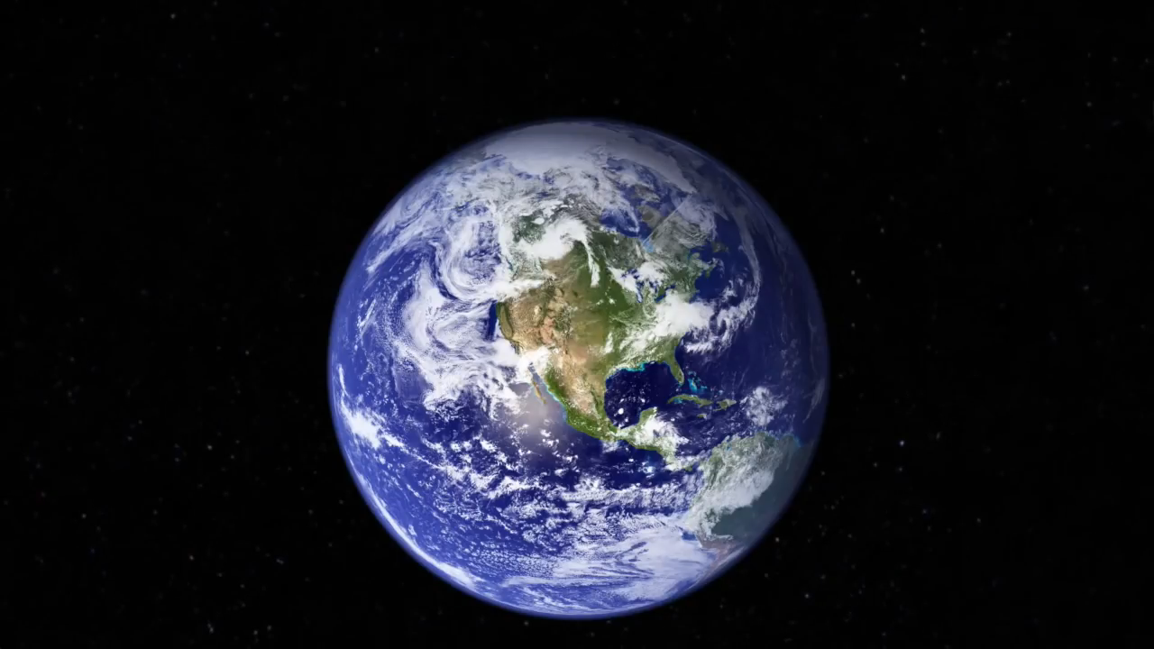
Notes:
Our earth lies within the solar system. The NASA.gov gives us a little more depth of information on this structure. The solar system we call home is located within the outer spiral arm of the vast Milky Way Galaxy. Our solar system consists of the sun (our star) and everything that orbits around it. Most memorably the 8 planets you see here- Mercury, Venus, Earth (of course), Mars, Jupiter, Saturn, Uranus, and Neptune.
Remember this is not to scale.

Slide 7
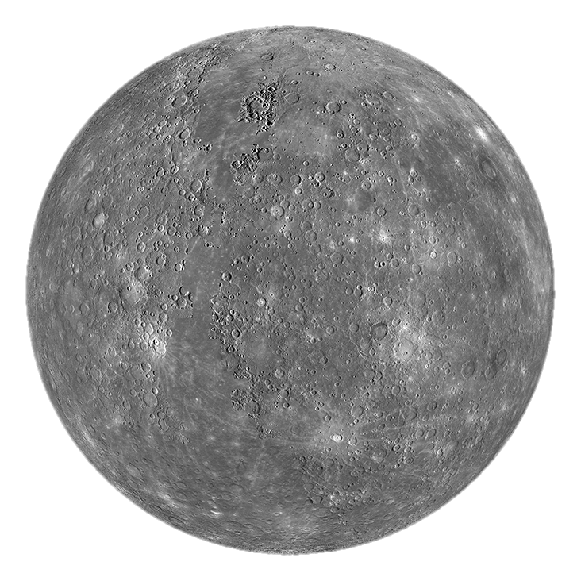
Notes:
Let’s begin the dissection of the solar system with the planet Mercury.
The temperatures on Mercury are extreme. According to NASA.gov, temperatures on the surface can reach up to 800 degrees Fahrenheit during the day and, due to the lack of an atmosphere to retain the heat, nighttime temperatures can drop to -290 degrees Fahrenheit.
Mercury is a speedy planet. It makes a full rotation around the sun every 88 days, going approximately 31 miles per second. Not per hour- but per SECOND.
One day-night cycle on Mercury equals 175.97 earth days. That is only a few days shy of 6 months.
As you can see from the picture, Mercury’s surface is similar to that of Earth’s moon- scarred with craters from collisions with meteoroids and comets.

Slide 8
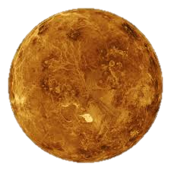
Notes:
The next planet going outwards from the sun is Venus and is about the same size as Earth. Information found on NASA.com orates that one day-night cycle on Venus can take about 117 Earth days and a complete orbit around the sun takes about 225 Earth days. This is slightly less than only 2 of the day-night cycles on the planet. This is due to the opposite rotation direction of Venus as opposed to the sun’s orbital revolution direction. Venus’ surface is made of rock and is therefore considered a Terrestrial planet. The planet has drastically high temperatures, up to 900 degrees Fahrenheit, making it not conducive for human or otherwise-life as we know it.

Slide 9
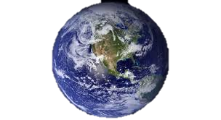
Notes:
Since Earth is our home planet, I will keep this brief.
Earth is the third planet from the sun and the largest of the terrestrial(non-gaseous) planets, and fifth largest planet overall.
The earth, when you put it into perspective to the other terrestrial planets in terms of size, composition, and geological processes isn’t that unique. However, the characteristic of human and other-wise life inhabitation usurps the “average-ness” of the planet.
70% of the Earth’s surface is covered by water and as recorded in the World Bank's World Development report in 2009, 95% of world's population is concentrated on just 10% of world's land surface. While only 10% of the world's land is classified as remote or more than 48 hours from a large city.

Slide 10
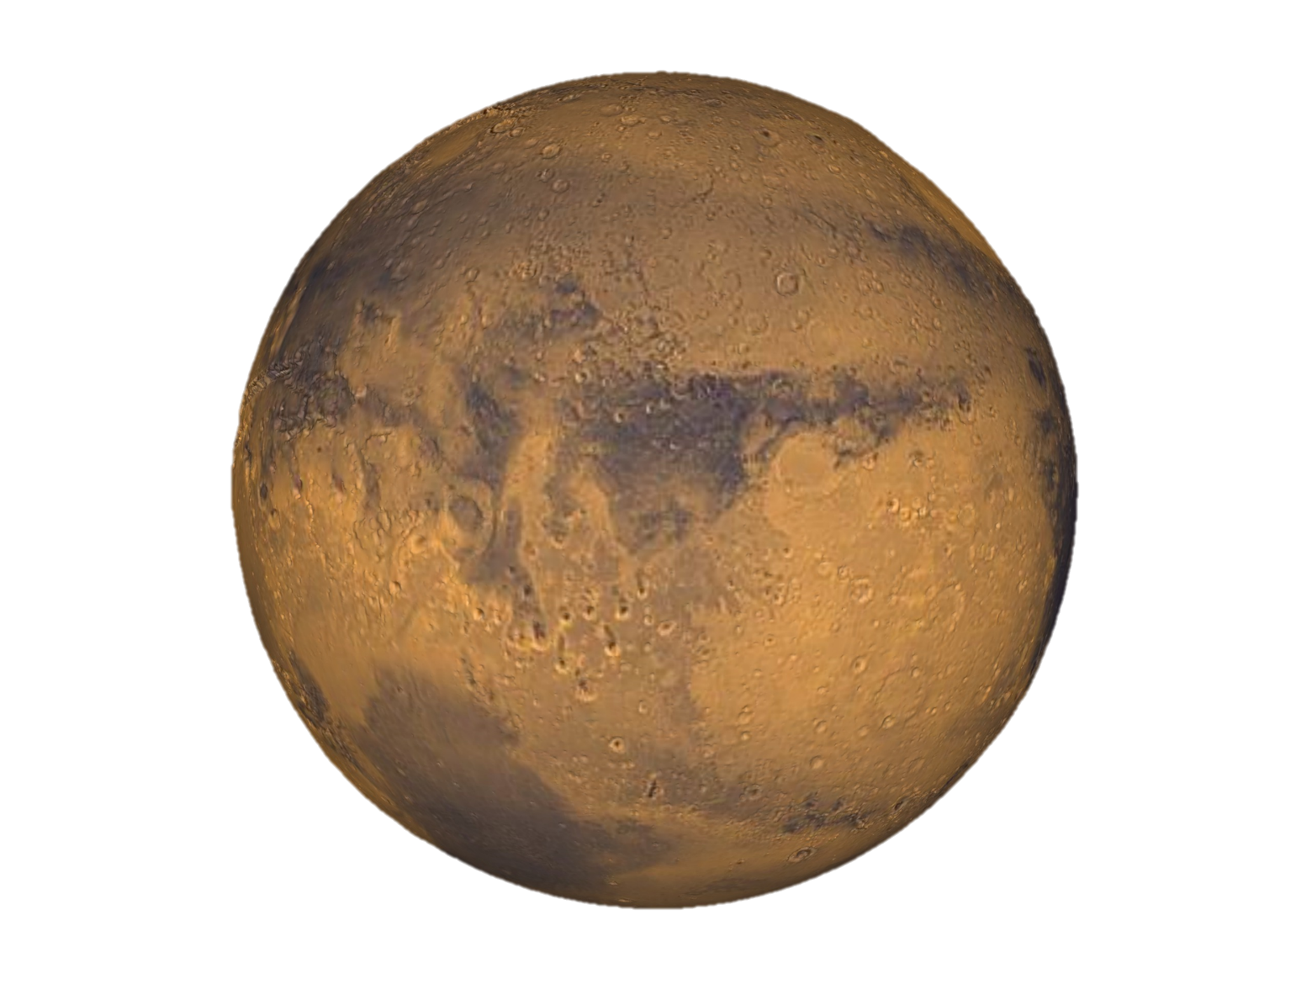
Notes:
Mars is the fourth planet from the sun and is about half the size of the Earth. Mars has two small moons that are so small that they may even have just been captured asteroids. Like earth, Mars has seasons. This is due to it’s rotational axis. Another similarity to earth is in the H20, or imprints of H20, as I will later describe.
In 2002, NASA’s Mars Odyssey orbiter found traces of considerable amounts of water ice close to the surface. The cold temperatures and very thin atmosphere on Mars do not allow for liquid water on the surface for lengthy periods so it is unusual to find the significant remains of huge channels, canyons, and flood plains where water evidently could have once flowed. It is the great mystery of Mars where the ancient flood water came from, how long it lasted, and where it went.

Slide 11
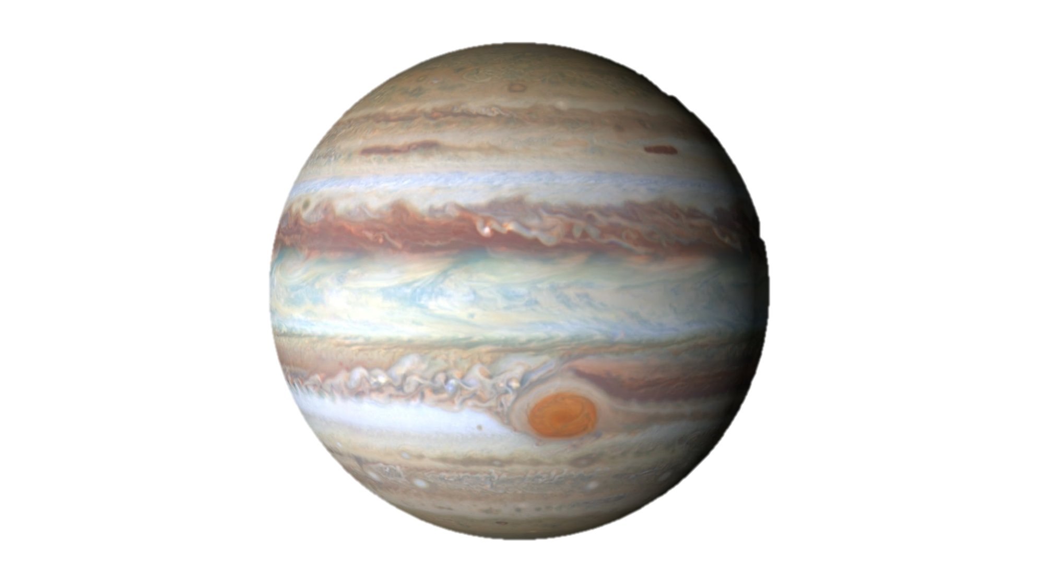
Notes:
Jupiter, the fifth planet from the sun, is wide enough to fit 11 Earths across its diameter. If you left the earth and went 1 million miles every day for a year, you would arrive at Jupiter. (It is about 365 million miles from the Earth.) Jupiter is a gas-giant. In other words, it does not have a solid surface like the other previous planets I’ve mentioned, Mercury, Venus, Earth, and Mars- which are considered Terrestrial Planets. Jupiter has more than 50 moons, with a few that have specific popularity due to their unique qualities, which I will discuss later. Jupiter is famous for it’s Great Red Spot. The Great Red Spot is a massive storm that has been raging on Jupiter's surface for at least 200 years. According to a recently published article on Space.com has grown to more than 50 times deeper than the Earth’s ocean and according to Sciencedaily the storm is large enough to contain two to three planets of Earth’s size.

Slide 12
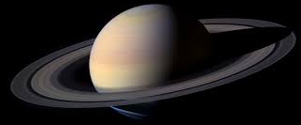
Notes:
Saturn is another gas giant and is the second largest planet in our solar system. One day on Saturn takes about 10.7 hours and a complete orbit around the sun takes about 29 Earth years. Saturn has 53 officially known moons, with several awaiting confirmation. Two well known moons that I will later discuss is Enceladus and Titan. Saturn is well known for it’s prominent 7-ring system with thousands of smaller ringlets as well as is known for being the farthest planet from Earth observable by the unaided human eye.

Slide 13


Notes:
NASA puts Saturn’s massive size in perspective, “If the sun were as tall as a typical front door, the Earth would be the size of a nickel and Saturn would be about as big as a basketball.

Slide 14
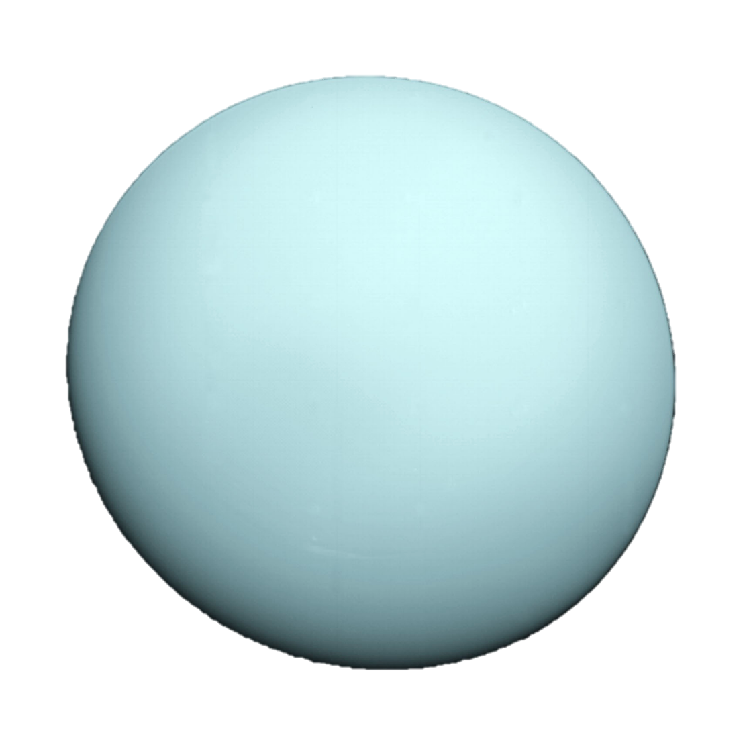
Notes:
Continuing this analogy, compared to the front-door sized sun and nickel sized Earth, Uranus would be as big as a baseball. Uranus is known as the sideways planet because of it’s unique 90-degree-angled axis. Because of this tilt, it looks like Uranus is spinning on it’s side, orbiting the sun like a rolling ball, as NASA’s website described. Uranus is the third largest diameter in our solar system. Uranus is an ice giant that is extremely cold and very windy. It is encircled by 13 hardly visible rings and 27 moons- each moon named after characters from the works of William Shakespeare and Alexander Pope.

Slide 15
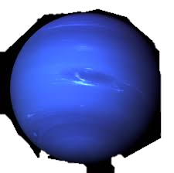
Notes:
Neptune is the farthest planet from the sun at 2.8 billion miles. No human has ever lived to see one full orbit of Neptune around the sun- it takes about 165 Earth years. Neptune has 13 moons that are all named after various sea gods and nymphs in Greek mythology. As described by space-facts.com, Neptune has a very active climate. Massive storms and crazy winds whirl around the planet at up to 600 meters per second- almost 2000 feet per second. According to Solarsystem.com, about 60 earths could fit inside of Neptune’s interior.

Slide 16
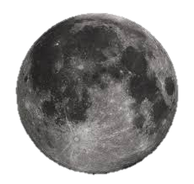
Notes:
Now that we have discussed the planets, we can further dissect the solar system by looking at some of the moons.
Most commonly known is Earth’s moon, our natural satellite. It is the fifth largest moon in our solar system and is the only place beyond Earth where humans have physically set foot. Our tides and our relatively stable climate is all a result of the moons effect on the earth’s axis and magnetic poles.
In an article written and published by Cornell University, it is stated that our moon is only simply called “the moon” because people didn’t know other moons existed until Galileo Galilei discovered four moons orbiting Jupiter in 1610. The name stuck.

Slide 17
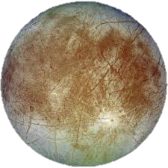
Notes:
One of the moons of Jupiter is Europa, which is just a little bit smaller than Earth’s moon.
Europa’s surface consists of ice crisscrossed by long fractures, as you can see from the picture. Europa is thought to have an ocean of salty water beneath its ice crust deep enough to reach all the way to it’s rocky mantle and iron core. Because of Europa’s location as one of Jupiter’s moons, the oceans surface would be globally frozen over. If this ocean is proven to be in existence, it is said it could be the most promising place in the solar system to search for signs of present-day life according to articles found not only on Space.com but also by NASA. This can only be further proven through future expeditions and research.

Slide 18
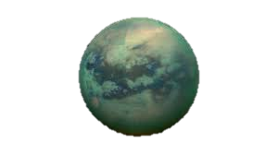
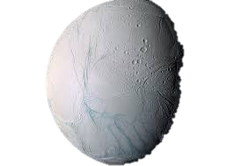
Notes:
Two natural wonders, Enceladus and Titan– Saturn’s moons.
Titan is Saturn’s largest moon and is the second largest moon in our solar system by only 2% to Jupiter’s moon Ganymede. Titan is even larger than the planet Mercury. According to the NASA research, Titan is the only moon in our solar system that has clouds and it’s own atmosphere made of nitrogen and methane – a very toxic for environment for humans. Nevertheless, it is the only other place in the solar system known to have an earthlike cycle of liquids flowing across the surface. Except, instead of H20, the rivers and lakes are made of liquid ethane and methane – the main components to natural gas. These liquids evaporate into the clouds and occasionally rain from the sky on Titan.
Enceladus is Saturn’s sixth largest moon, but it’s lack of size is made up for in its intrigue. Enceladus has hydrothermal vents, similar in a way to those in Yellowstone National Park. These hydrothermal vents spew water vapor and ice particles from the underground ocean beneath Enceladus’s icy crust. Enceladus is one of the brightest and most reflective mass in our solar system. The ice covering the surface reflects sunlight as snow does on a bright day. Because it reflects so much sunlight, the temperature on Enceladus’s surface is ridonkulously cold, about -330 degrees Fahrenheit.

Slide 19
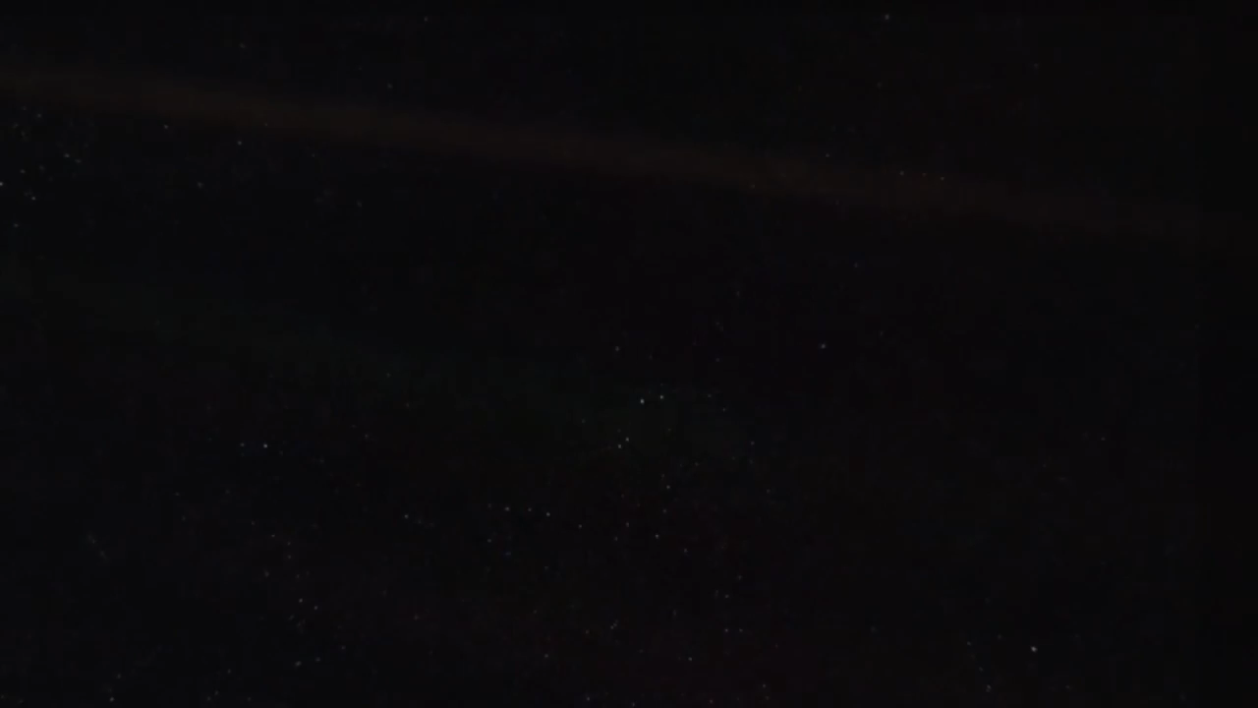
Notes:
Without the sun, the center of our solar system, none of this would be possible. The sun is 432,168.6 miles wide, reports NASA. However, as you can see from this video the sun is not nearly the largest known star. The sun, the life-force of our entire planet and solar system, in charge of the tides, the seasons, the climate, and our survival, pales in comparison to the magnitude of some other stars. There are billions of stars just like our sun scattered across the Milky Way galaxy, some with the possibilities of their own systems and their own life that we just haven’t found yet.

Slide 20
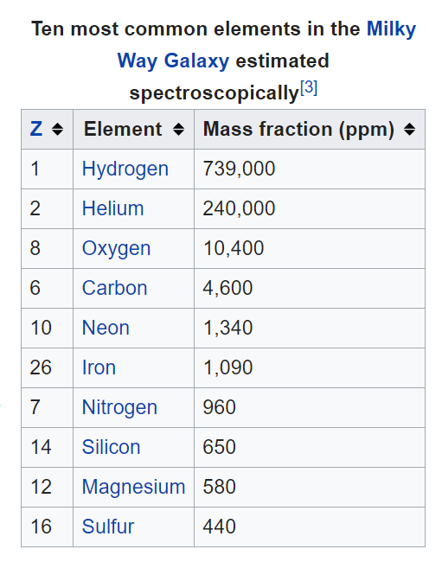
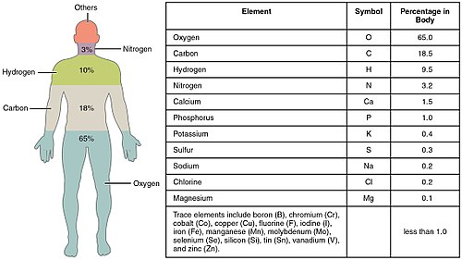
Notes:
What makes us so connected to the rest of the universe? The very things we are made out of. Its down to the elemental level. If you see from these diagrams, we consist most primarily of the same elements that make up the Milky Way Galaxy- Oxygen, Carbon, Hydrogen, and Nitrogen.

Slide 21
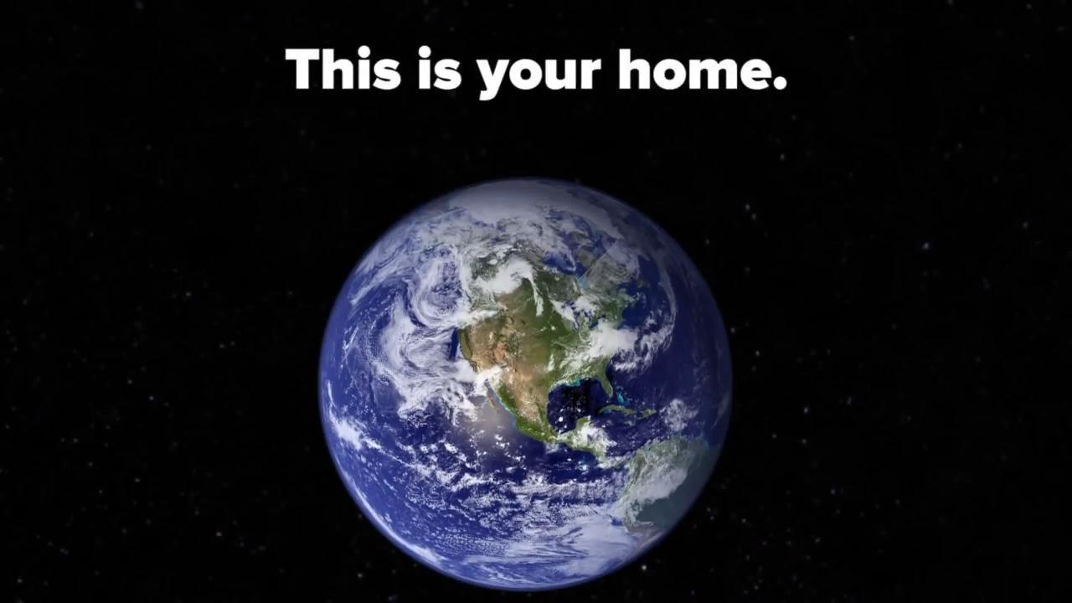
Notes:
This has only been a brief summary of a few of the components that make up only our solar system. This is only a microscopic chunk of what is out there.
I hope through this presentation you have been able to find at least one interesting fact about space, may it be Jupiter’s unique moons or the strange rotation of Venus causing it’s orbit to last only two of it’s days. There is so much out there to learn about the universe and there is still so much to find. With planets boasting storms as deep as our oceans and moons containing oceans as deep or deeper than our own- there is information that could intrigue anyone if they took the time, and the space.

